Slide 1

AZURE VIRTUAL MACHINE
By - Bharani kumar B
INT00875

Slide 2
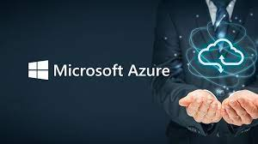
About Azure
Initial release date: 1 February 2010
Developer: Microsoft Corporation
Operating system: Linux, Microsoft Windows, iOS, Android

Slide 3
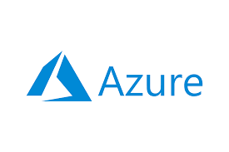
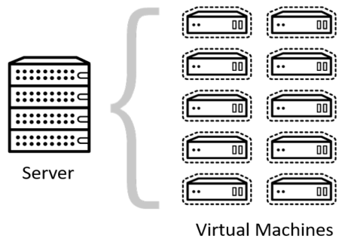
What is Azure?
Azure is a cloud computing platform operated by Microsoft that provides access, management, and development of applications and services via around the world-distributed data centers.
What is Azure virtual machine?
Azure virtual machine is one of the wide range of services that azure offers to create your instance.
Each visual machine provides its own virtual hardware including memory, hard drives, network interfaces and other devices

Slide 4
Virtual Machine Prices
Azure VM has two kind of pricing modals:
Pay as you Go – This modal charge only for the time compute resource like Azure VM is used. It does not have any long-term commitment or any fixed monthly charges.
Reserved Instances – This plan brings an advanced purchase option for a reserved VM instance for a period of 1 or 3 years. With this, users get up to 72 % price savings than pay as you go plan. Reserved Virtual machines can easily be replaced with another one in case of any downgrade in performance.

Slide 5
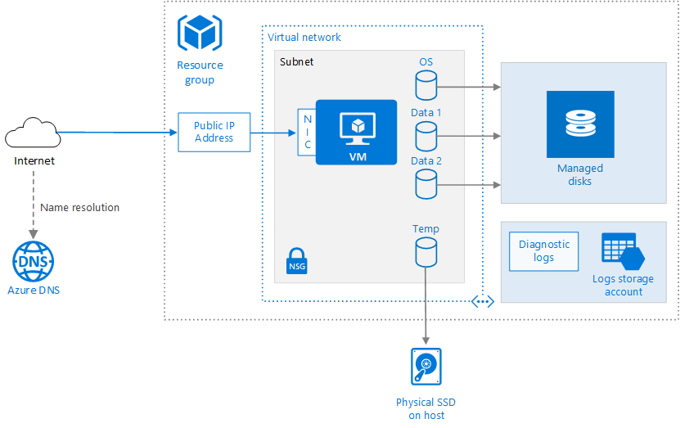
Virtual Machine Architecture

Slide 6
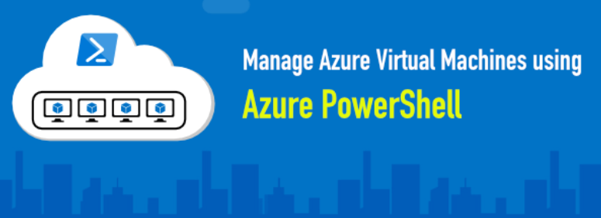
Manage Azure virtual machine
You can perform the following actions on azure instance, without leaving the console.
Add and remove one or more azure subscriptions by using VMM console
See a list view with details
Manually refresh the list of instances
Administrator can now manage and maintain Azure Virtual Machines and Azure Cloud Services from the local Computer using Azure PowerShell

Slide 7

Advantages of Azure virtual machine
Hardware scalability
Operating system
Multiple user
Disaster Recovery
Security

Slide 8


